Slide 1
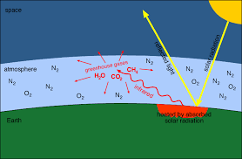
Greenhouse Gases: Chemistry and Their Role in Global Warming
An in-depth exploration of key greenhouse gases (CO₂, CH₄, N₂O, H₂O vapor), their chemical behavior, and strategies for mitigation.

Slide 2
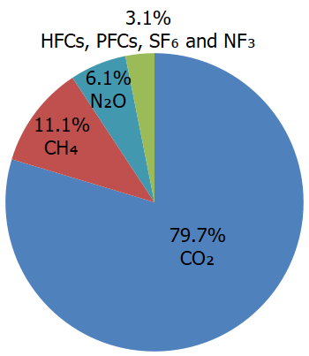
Understanding Greenhouse Gases
Greenhouse gases trap heat in Earth's atmosphere.
They contribute to the greenhouse effect and global warming.
Major GHGs: CO₂, CH₄, N₂O, and H₂O vapor.

Slide 3
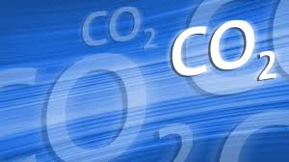
Carbon Dioxide (CO₂)
Sources: Fossil fuel combustion, deforestation.
Properties: Long atmospheric lifetime (~100 years).
Role: Primary contributor to anthropogenic warming.

Slide 4
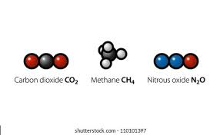
Methane (CH₄) and Nitrous Oxide (N₂O)
CH₄: Emitted from agriculture (ruminants), landfills, fossil fuel extraction.
N₂O: Originates from fertilizer use, industrial activities.
Both have higher GWP than CO₂ over 100 years.

Slide 5

Water Vapor (H₂O)
Most abundant GHG but acts as a feedback, not a direct forcing.
Increased by warming, enhances the greenhouse effect.
Highly variable in atmosphere.

Slide 6
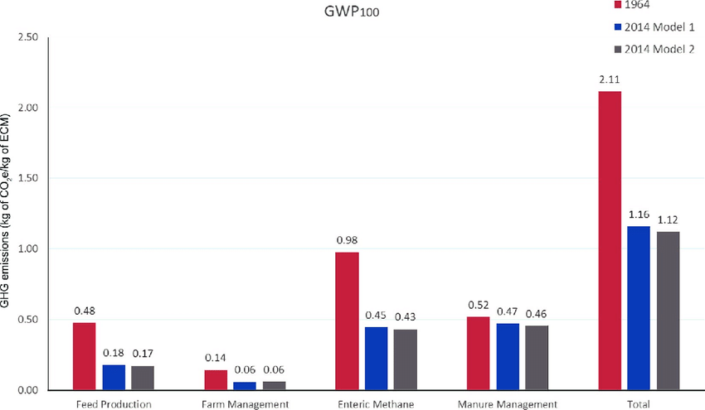
Comparing Global Warming Potentials
GWP (100 years):
CO₂ = 1
CH₄ ≈ 28-36
N₂O ≈ 265-298
Highlights importance of targeting high-GWP gases despite lower concentrations.

Slide 7
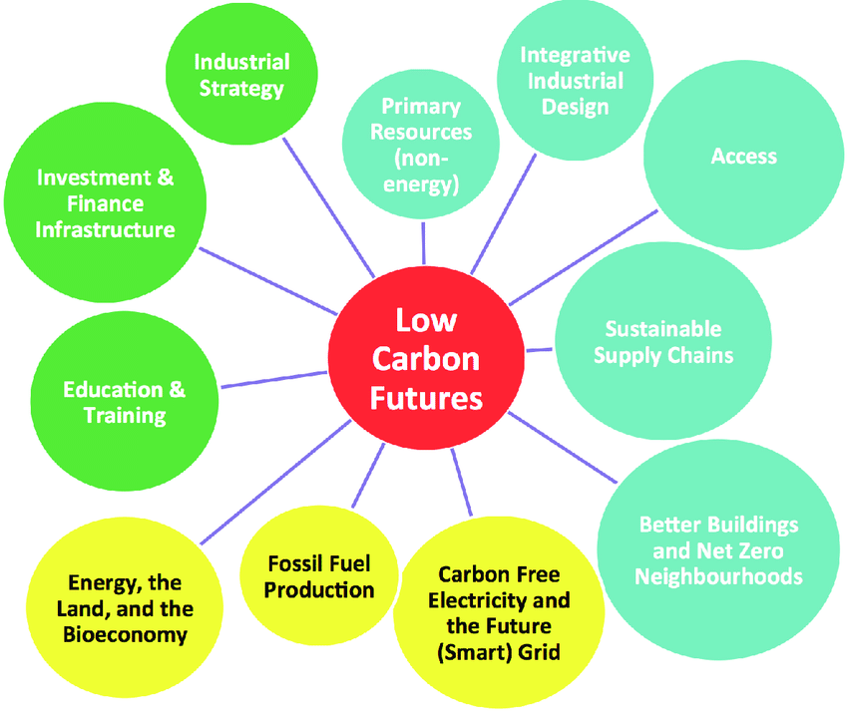
Mitigation Strategies
• Transition to renewable energy
• Improve energy efficiency
• Promote sustainable agriculture
• Implement carbon pricing
• Enhance carbon sinks (e.g., forests)

Slide 8

Conclusion
Greenhouse gases differ in sources and impacts.
Reducing emissions requires science-based strategies and global cooperation.
Every action counts toward a more stable climate.

